Slide 1
UNIT-3 Public-Key Cryptosystems Applications for Public-Key Cryptosystems Requirements for Public-Key Cryptography

Slide 2
All cryptographic systems have been based on the elementary tools of substitution and permutation.
public-key algorithms are based on mathematical functions rather than on substitution and permutation. More important, public-key cryptography is asymmetric, involving the use of two separate keys.
The use of two keys has profound consequences in the areas of confidentiality, key distribution, and authentication

Slide 3
Public-Key Cryptosystems:
Asymmetric algorithms rely on one key for encryption and a different but related key for decryption. These algorithms have the following important characteristic.
It is computationally infeasible to determine the decryption key given only knowledge of the cryptographic algorithm and the encryption key

Slide 4
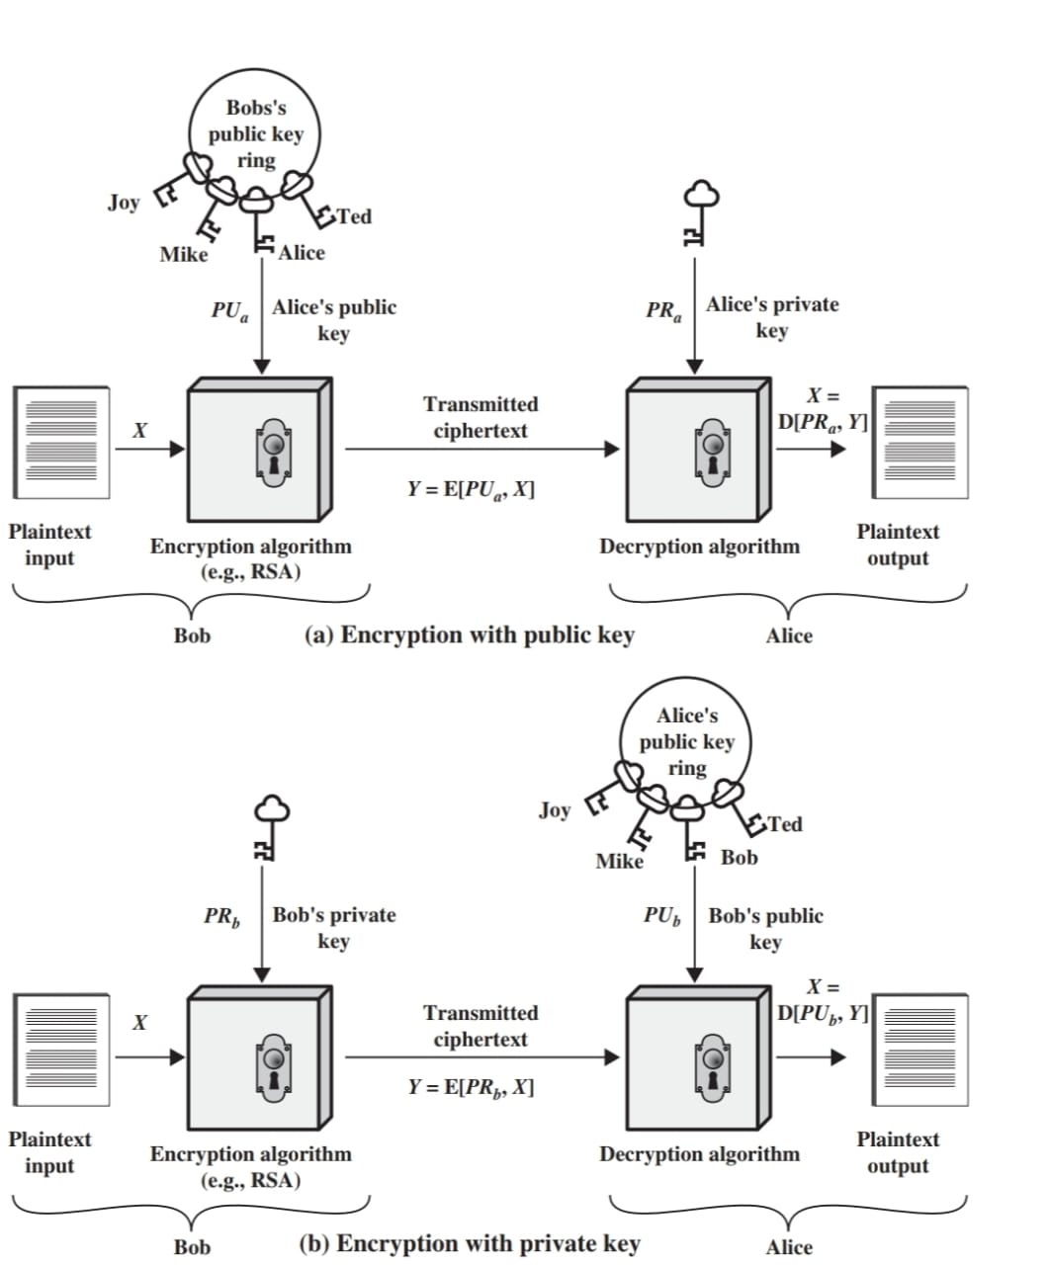
A public-key encryption scheme has six ingredient

Slide 5
1. Plaintext
2.Encryption algorithm
3. Public and private keys
4.Ciphertext
5. Decryption algorithm
Is figure(a) provide authentication????
We mentioned earlier that either of the two related keys can be used for encryption, with the other being used for decryption.
This enables a rather different cryptographic scheme to be implemented. Whereas the scheme illustrated in Figure (a)provides confidentiality,
Figures b the use of public-key encryption to provide authentication:

Slide 6
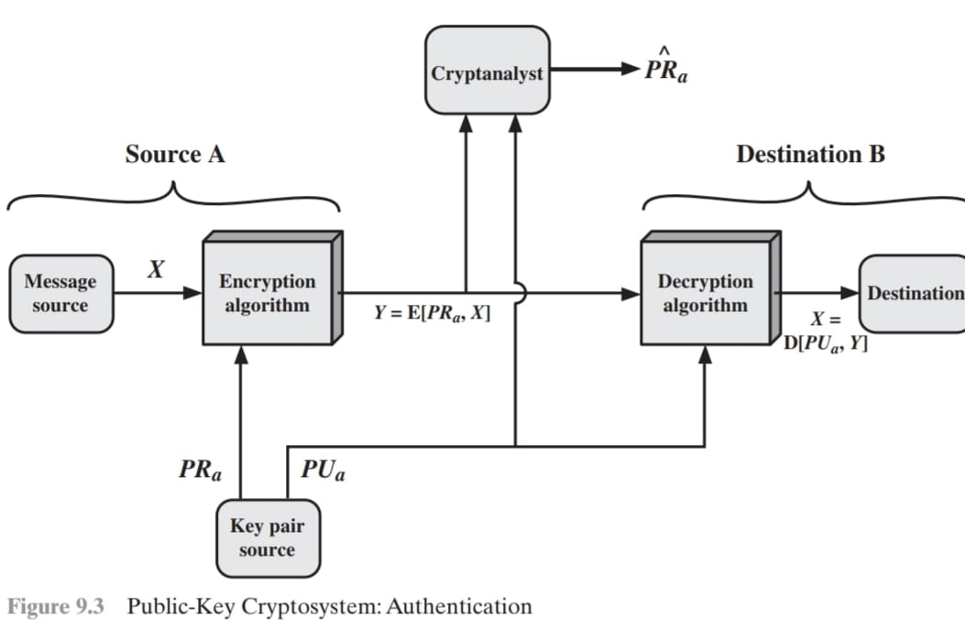
Y = E(PRa, X)
X = D(PUa, Y)

Slide 7
in the case of complete encryption, as shown in Figure 9.3, there is no protection of confidentiality because any observer can decrypt the message by using the sender’s public key.
It is, however, possible to provide both the authentication function and confidentiality by a double use of the public-key scheme

Slide 8
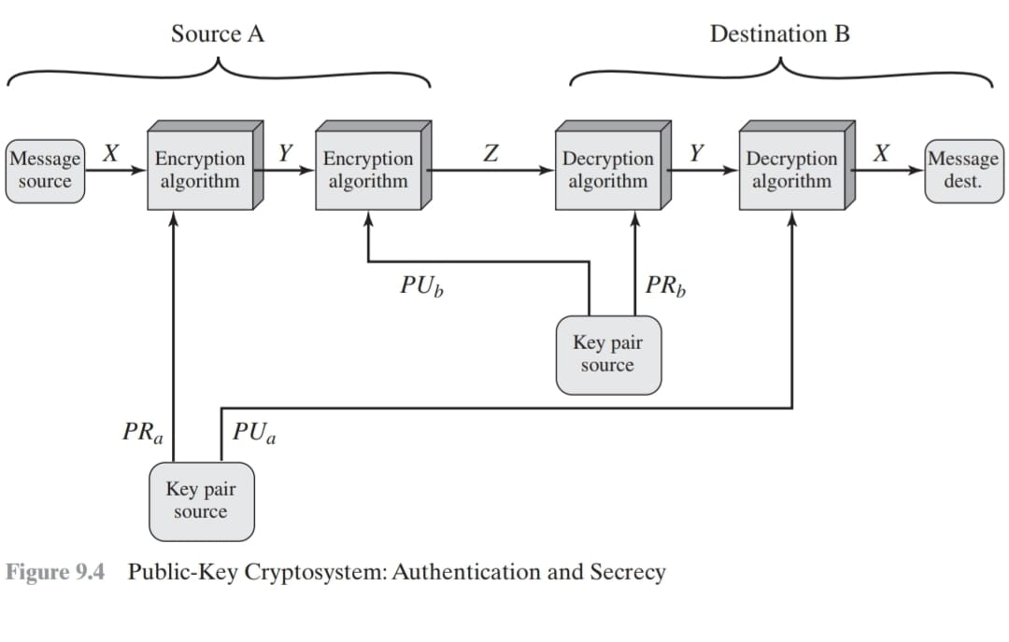
Z = E(PUb, E(PRa, X))
X = D(PUa, D(PRb, Z))

Slide 9
Applications for Public-Key Cryptosystems
Depending on the application, the sender uses either the sender’s private key or the receiver’s public key, or both, to perform some type of cryptographic function. In broad terms, we can classify the use of public-key cryptosystems into three categories:
1. Encryption /decryption: The sender encrypts a message with the recipient’s public key
2. Digital signature: The sender “signs” a message with its private key. Signing is achieved by a cryptographic algorithm applied to the message or to a small block of data that is a function of the message.
3. Key exchange: Two sides cooperate to exchange a session key

Slide 10
Requirements for Public-Key Cryptography
Diffie and Hellman did lay out the conditions that such algorithms must fulfill.
1.Key Generation must be easy.
2.Encryption must be computationally easy.
3.Decryption must be easy if have private key.
4.Just because public key available ,no one should be able to calculate the private key.
5.If public key and cipher text available to adversary it mut be computationally infeasible to recover original message.
6.System can use two keys in either order.

Slide 11
RSA
by Rivest, Shamir & Adleman of MIT in 1977
based on exponentiation in a finite (Galois) field over integers modulo a prime.
It supports key management concept, it is key generation.
Notes:
RSA is the best known, and by far the most widely used general public key encryption algorithm.

Slide 12
RSA
RSA makes the public and prívate keys by multiplying two large prime numbers p and q
Its easy to find & multiply large prime No. (n=pq)
It is very difficult to factor the number n to find p and q
Finding the private key from the public key would require a factoring operation
The real challenge is the selection & generation of keys.
RSA is complex and slow, but secure
100 times slower than DES on s/w & 1000 times on h/w.

Slide 13
Algorithm
Choose two different prime number P, Q
Calculate N=P*Q
ɸ(n)=(P-1)*(Q-1)
choose ’e’ such that 1<e<ɸ(n)
e is co prime to ɸ(n),gcd(e,ɸ(n))=1
calculate d such that de≅1 modɸ(n)or [demodɸ(n)]=1 or de=1+kɸ(n)
Public key e and private key d
CT=PT^{e}mod N
PT=CT^{d}modN

Slide 14
Example
P=7, Q=17
(N)119=7*17
ɸ(n)=(7-1)*(17-1)= 6*16 =96 factor 2 & 3, so e(public)=5
de=1+kɸ(n)[k=0,1,2,3….] so d=77{if plain text 10}
CT=10⁵ mod 119 =100000 mod 119 =40
Send 40
PT=40⁷⁷ mod 119 = 10

Slide 15
RSA Security
It uses prime number theory which make it difficult to find out the key by reverse engineering.
Mathematical Research suggests that it would take more than 70 years to find P & Q if N is a 100 digit number.

Slide 16
HASH FUNCTION:
A hash function H accepts a variable-length block of data as input and produces a fixed-size hash value h = H(M).
A “good” hash function has the property that the results of applying the function to a large set of inputs will produce outputs that are evenly distributed and apparently random.
The principal object of a hash function is data integrity. A change to any bit or bits in results, with high probability, in a change to the hash code.

Slide 17
The kind of hash function needed for security applications is referred to as a cryptographic hash function.
Application:
1.Message Authentication:- Message authentication is a mechanism or service used to verify the integrity of a message. Message authentication assures that data received are exactly as sent (i.e., contain no modification, insertion, deletion, or replay)
When a hash function is used to provide message authentication, the hash function value is often referred to as a message digest.

Slide 18
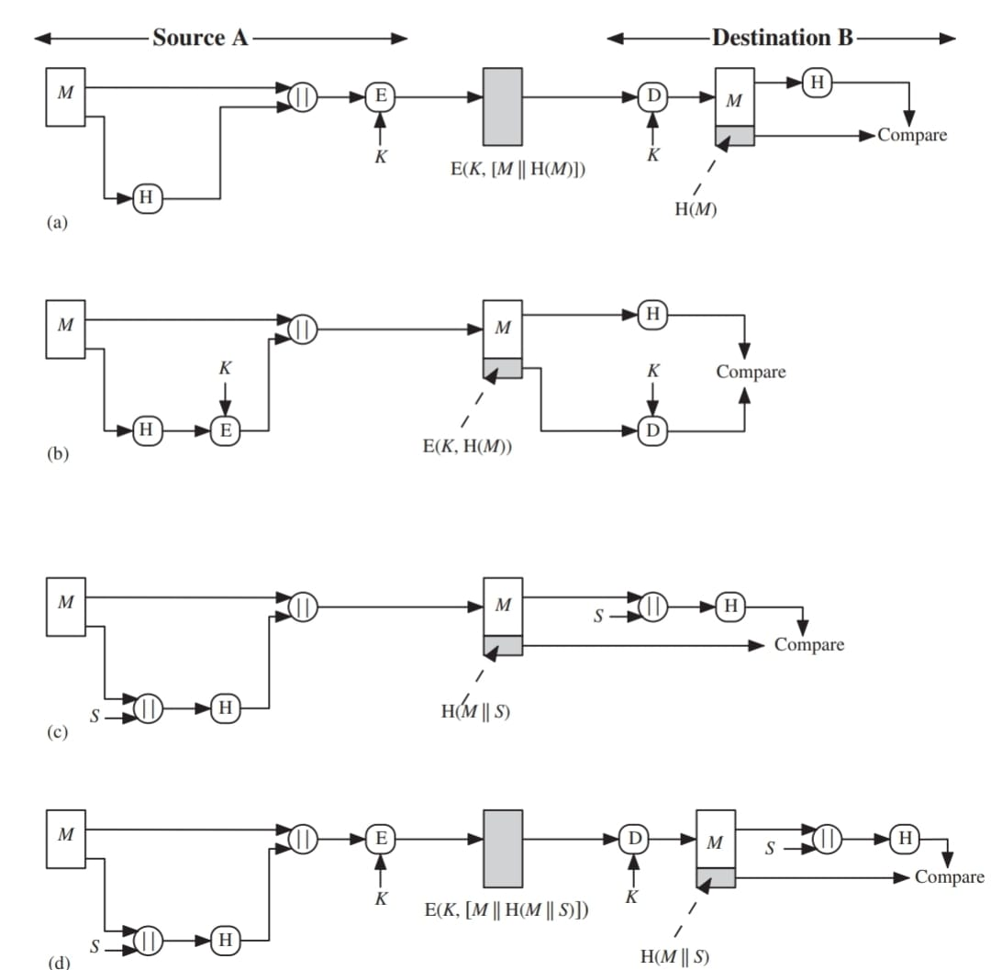

Slide 19
(A): . The message plus concatenated hash code is encrypted using symmetric encryption. . Because encryption is applied to the entire message plus hash code, confidentiality is also provided.
(B) . Only the hash code is encrypted, using symmetric encryption. This reduces the processing burden for those applications that do not require confidentiality
(C) It is possible to use a hash function but no encryption for message authentication. The technique assumes that the two communicating parties share a common secret value .
(D) . Confidentiality can be added to the approach of method (c) by encrypting the entire message plus the hash code.

Slide 20
Message authentication is achieved using a message authentication code (MAC), also known as a keyed hash function.
MACs are used between two parties that share a secret key to authenticate information exchanged between those parties.
2.Digital Signatures: the hash value of a message is encrypted with a user’s private key.
(A) The hash code is encrypted, using public-key encryption with the sender’s private key. this provides authentication.
(B) If confidentiality as well as a digital signature is desired, then the message plus the private-key-encrypted hash code can be encrypted using a symmetric key.

Slide 21
3. Other Applications: used to create a one-way password file
used for intrusion detection and virus detection.
used to construct a pseudorandom function (PRF) or a pseudorandom number generator (PRNG).

Slide 22
Simple Hash Functions:
1.One of the simplest hash functions is the bit-by-bit exclusive-OR (XOR) of every block.
This can be expressed as
Ci = bi1 XOR bi2 XOR………XOR bim
where Ci = i th bit of the hash code, 1 … i … n
m = number of n-bit blocks in the input
bij = ith bit in the jth block
2. A simple way to improve matters is to perform a one-bit circular shift, or rotation, on the hash value after each block is processed.
(1) Initially set the -bit hash value to zero.
(2)Process each successive -bit block of data as follows: a. Rotate the current hash value to the left by one bit.
b. XOR the block into the hash value

Slide 23
Requirements and security:
1.For a hash value ,
h=H(x)
Here, x is the preimage of h,
x is a data block whose hash function is h.
2.H is a many-to-one mapping.so for given value h there will be many preimages.
3.A collision occur if x!=y and H(x)=H(y)

Slide 24
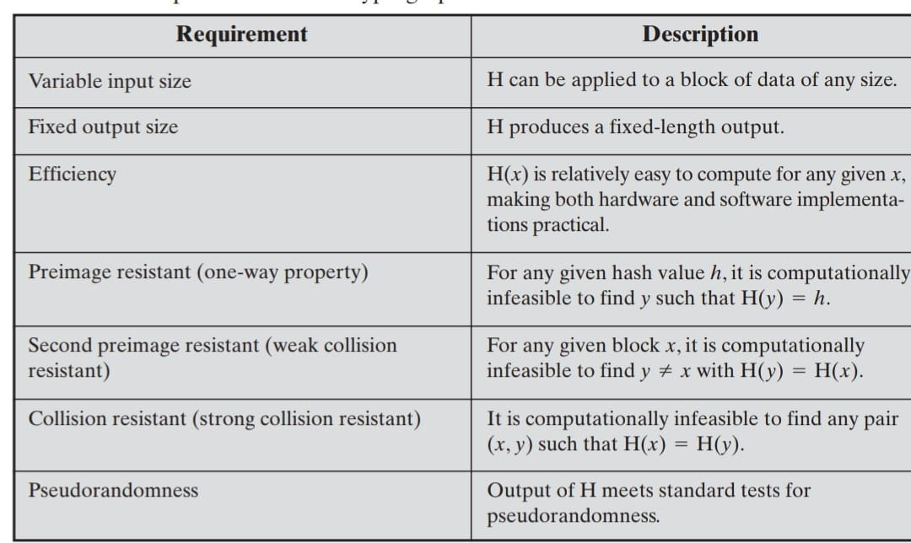
Security Requirements for Cryptographic Hash Functions:

Slide 25
Second Preimage Resistant (Weak Collision Resistance):It means if someone already gives you a message and its hash, you should not able to find a different message which gives same hash value.(one message is fixed (the attacker doesn’t get to choose it).
Collision Resistant (Strong Collision Resistance):the attacker is free to pick both messages. It should be infeasible to find any two distinct inputs x and y such that H(x)=H(y)

Slide 26
Secure Hash Algorithem(SHA):
1.SHA was developed by the National Institute of Standards and Technology (NIST).
2.When weaknesses were discovered in SHA, now known as SHA-0.
3.Revised version was issued as FIPS 180-1 in 1995 and is referred to as SHA-1. SHA-1 produces a hash value of 160 bits.
4. SHA, with hash value lengths of 256, 384, and 512 bits, known as SHA-256, SHA-384, and SHA-512, respectively. Collectively, these hash algorithms are known as SHA-2.

Slide 27
SHA-512 Logic:
The algorithm takes as input a message with a maximum length of less than 2^128bits and produces as output a 512-bit message digest.
The input is processed in 1024-bit blocks

Slide 28
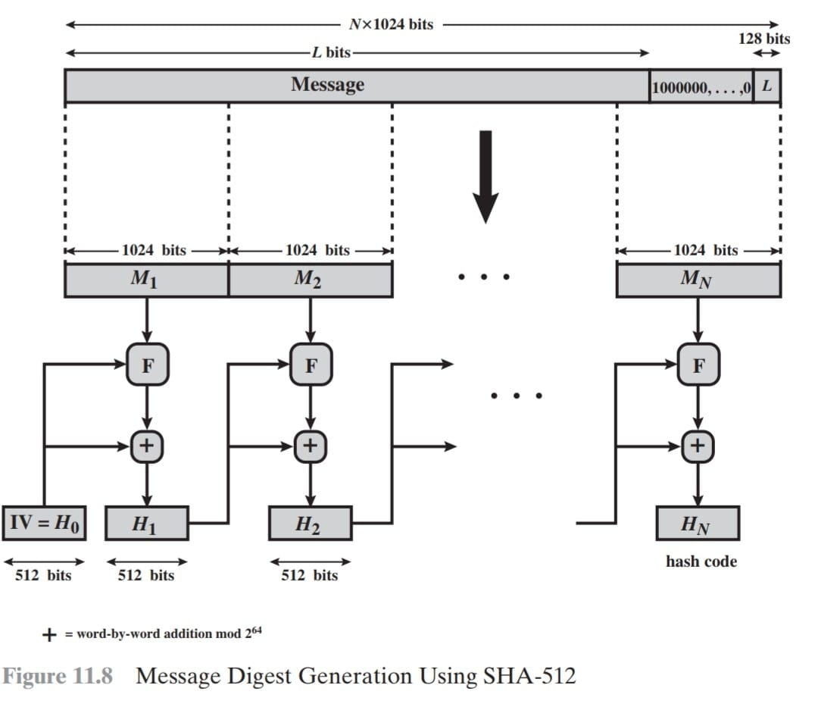

Slide 29
Step 1:Append padding bits: message is padded so length becomes a multiple of 1024 bits.
append a single 1 bit, append enough 0s,
Step 2: Append length. append the 128 bit binary representation of L(message length before padding).
Step 3:Initialize hash buffer. A 512-bit buffer is used to hold intermediate and final results of the hash function. The buffer can be represented as eight 64-bit registers (a, b, c, d, e, f, g, h). These words were obtained by taking the first sixty-four bits of the fractional parts of the square roots of the first eight prime numbers.

Slide 30
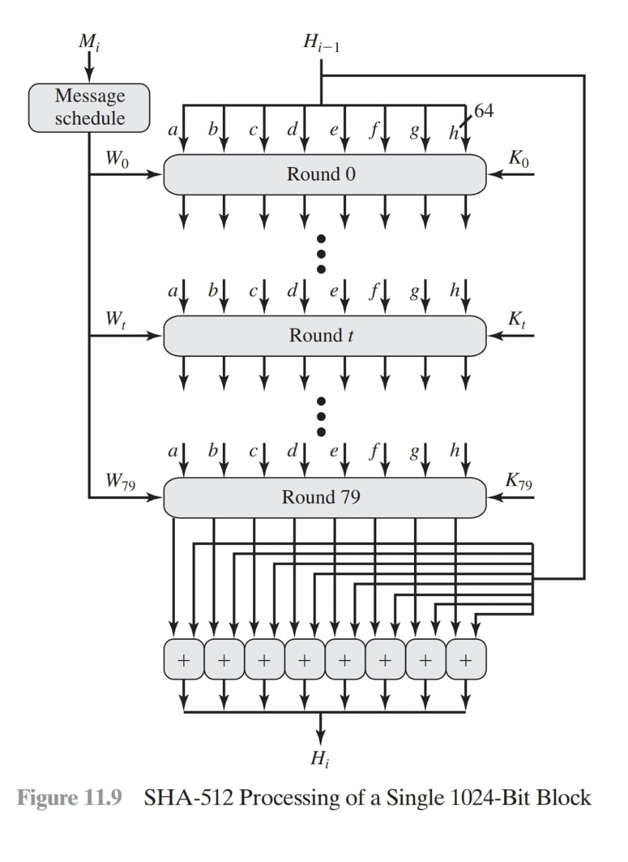

Slide 31
Step 4 :Process message in 1024-bit (128-word) blocks. The heart of the algorithm is a module that consists of 80 rounds; this module is labeled F.
The constants(K) provide a “randomized” set of 64-bit patterns, which should eliminate any regularities in the input data.
Step 5 Output. After all N 1024-bit blocks have been processed, the output from the N th stage is the 512-bit message digest.

Slide 32
We can summarize the behavior of SHA-512 as follows:
H0 = IV
Hi = SUM64(Hi-1, abcdefghi )
MD = HN

Slide 33
Message authentication code (MAC):
Message authentication is a procedure to verify that received messages come from the alleged source and have not been altered. Message authentication may also verify sequencing and timeliness.
A function of the message and a secret key that produces a fixed-length value that serves as the authenticator.

Slide 34
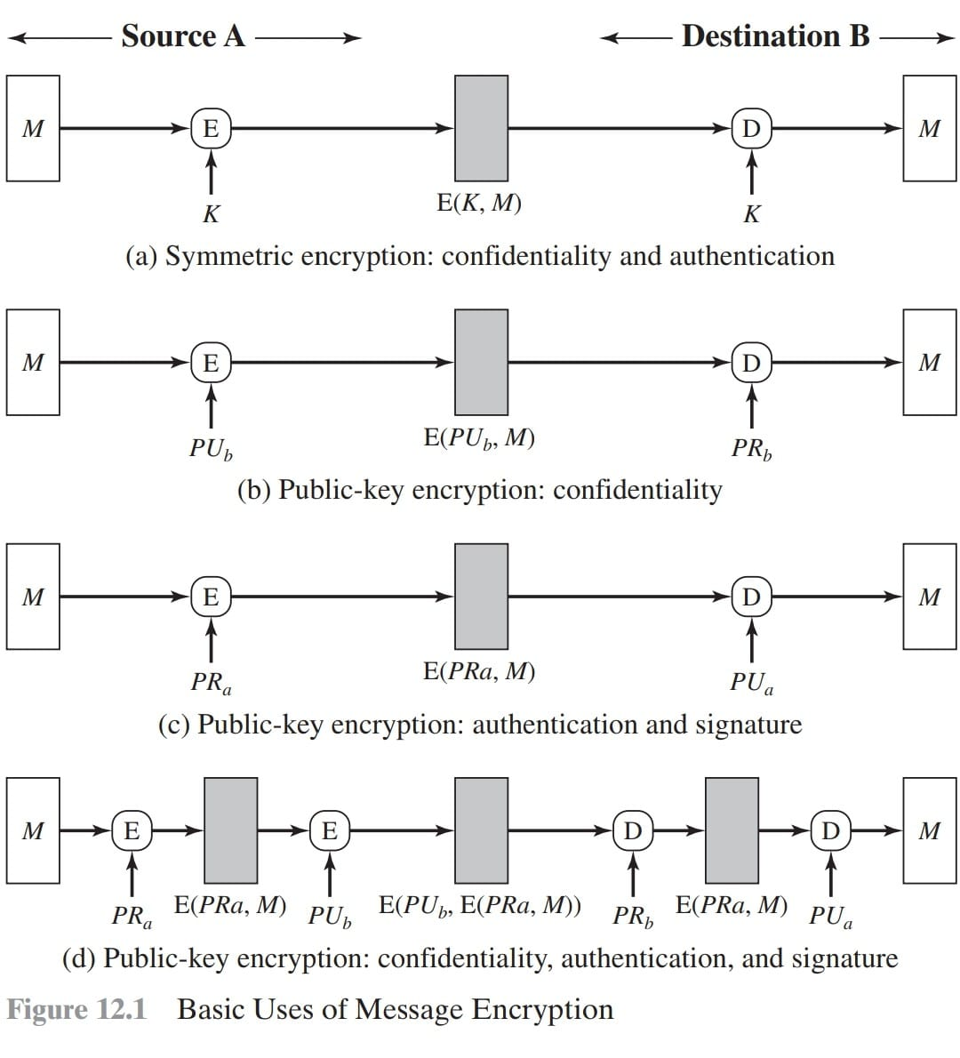

Slide 35
Message encryption: Symmetric:If any bit of pattern is accepted as a message, cannot check authenticity. valid messages helps in authentication.
Need to make sure that plaintext is authentic.
Solution: Add structure(Error Detecting Code)
Internal error control: M+FCS(frame check sequence) then encrypt
External error control: First encrypt message, FCS is calculated from ciphertext then send ciphertext +FCS
An error-control code is just one example ; any sort of structuring added to the transmitted message serves to strengthen the authentication capability.

Slide 36
Message Authentication Code:
Use of a secret key to generate a small fixed-size block of data, known as a cryptographic checksum or MAC, that is appended to the message.
MAC = C(K, M)
where M= input message
C = MAC function
K= shared secret key
MAC = message authentication code

Slide 37
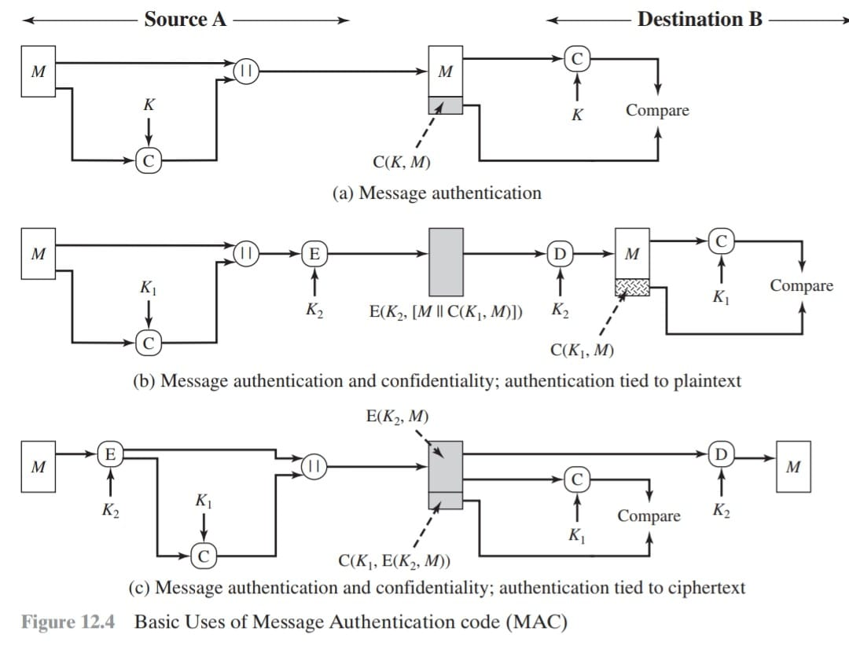

Slide 38
Requirements for MAC:
A MAC, also known as a cryptographic checksum, is generated by a function C of the form
T = MAC(K, M)
Where M is a variable-length message,K is a secret key shared only by sender and receiver, and MAC( K, M) is the fixed-length authenticator, sometimes called a tag.
1.An attacker should not able to create a new valid message-tag pair without secret key.
2.Protection against brute force attack with chosen plain texts.so longer tags should be chosen.
3.MAC must protect entire message equally.

Slide 39
Security of MAC: Attacks on MACs are grouped into two types
1.Brute force attacks :trying all possibilities ,it is harder on MAC than on hash
2.cryptanalysis:exploiting weaknesses in algo

Slide 40
MAC based on Hash function(HMAC):
1.WHY use hash functions for MACs?
Hash functions line MD5,SHA are faster .
Hash function libraries are widely available,so implementation is easier.
2.Problem with plain hash functions:
A normal hash does not use secret key.
3.HMAC=hash function + secret key

Slide 41
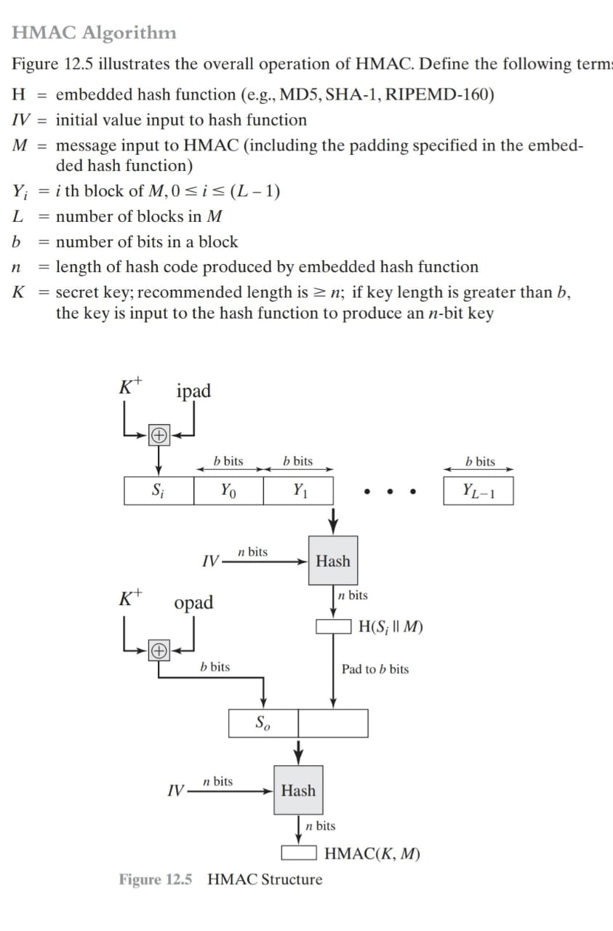

Slide 42
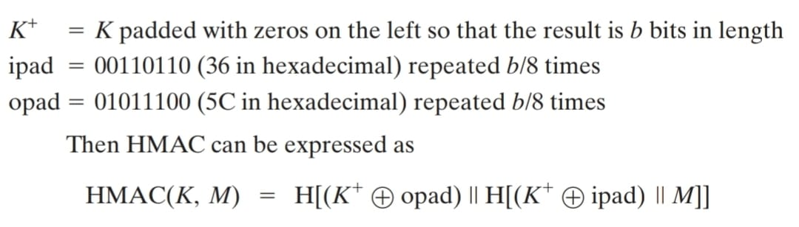

Slide 43
HMAC Algo:
1.Normalize the key to one block(K+):If the key is longer than block size b, replace it with H(K).then pad the key with zero bytes on the right so it becomes exactly b bits.this padded value is K+.
2.Create the inner and outer “tarting blocks”
Si=K+ XOR ipad (ipad =0x36)
So=K+ XOR opad (opad=0x5c)
3.Compute inner hash : Append the message to the inner block Si||M than
Compute inner=H(Si||M)
4.Prepare the outer input:Treat inner as the message for the outer hash, if needed its fed to hash function.
5.Compute the outer hash:So || inner
Now compute HMAC=H(So || inner)
This is final n bit HMAC tag.
We can send this with the message.

Slide 44
Digital Signature

Slide 45

Authentication Protocol
Authentication Application

Slide 46
Authentication Protocol
Users wish to access services on servers.
used to convince each others identity and to exchange session keys.
Require the user to prove his identity for each service invoked
Require that servers prove their identity to clients
Provide security in a distributed architecture consisting of dedicated user workstations (clients), and distributed or centralized servers.
may be one-way or mutual.

Slide 47
Security Concerns
key concerns are
Confidentiality:-encrypt identification and session key info.
Timestamp:- to prevent replay attacks.
by using sequence numbers

Slide 48
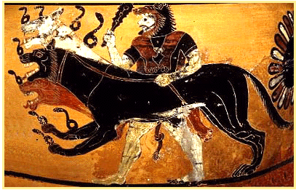
Kerberos
In Greek mythology, a many headed dog, the guardian of the entrance of Hades

Slide 49
What is Kerberos?
Developed as part of Project Athena at MIT
Open Source hence freely available
Provides centralised private-key third-party authentication in a distributed network
Provides single sign-on capability
Passwords (i.e: Secret Key) never sent across network
Key revocation can be achived by disabling a user at KDC.

Slide 50
How does Kerberos Works?
Uses an Authentication Server (AS)
Knows all user passwords, and stores in a DB
Shares a unique secret key with every user.
Send an encrypted ticket granting ticket
TGT contains a lifetime and timestamp

Slide 51
How does Kerberos Works?
Uses a Ticket Granting Server (TGS)
Issues tickets to users authenticated by AS.
Encrypted with a key only known by AS and TGS
Returns a service granting ticket
Service granting ticket contains timestamp and lifetime

Slide 52
Kerberos Dialog
Message Exchanges
Simplified approach
Client asks authentication server for ticket
AS exchange to obtain ticket-granting ticket
AS grants ticket
TGS exchange to obtain service granting ticket
Client sends ticket to server
Client/Server authentication exchange to obtain service

Slide 53
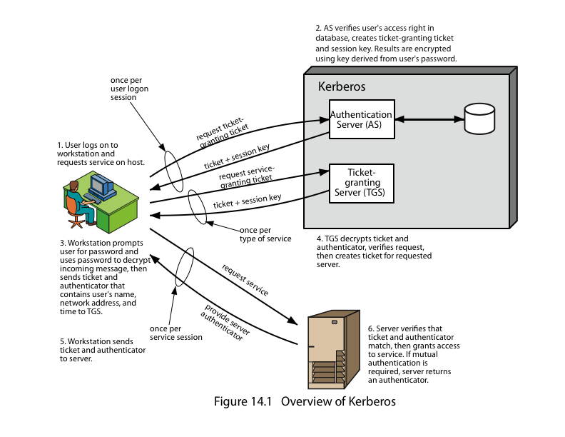

Slide 54
XYZ Service
SERVER
Key
Distribution
Center
Ticket
Granting
Service
Think “Kerberos Server” and don’t let yourself get mired in terminology.
Authen-
Tication
Service
Gurukul
Desktop
Computer
USER

Slide 55
XYZ Service
Key
Distribution
Center
Ticket
Granting
Service
“I’d like to be allowed to get tickets from the Ticket Granting Server, please.
Authen-
Tication
Service
Gurukul
Desktop
Computer
UID
USER
UID&PW

Slide 56
XYZ Service
Key
Distribution
Center
Ticket
Granting
Service
“Okay. I locked this box with your secret password. If you can unlock it, you can use its contents to access my Ticket Granting Service.”
Authen-
Tication
Service
Gurukul
Desktop
Computer
USER

Slide 57
XYZ Service
Key
Distribution
Center
Ticket
Granting
Service
Authen-
Tication
Service
Gurukul
Desktop
Computer
TGT
My Password
USER

Slide 58
TGT
Because Gurukul was able to open the box (decrypt a message) from the Authentication Service, he/she is now the owner of a “Ticket-Granting Ticket”.
The Ticket-Granting Ticket (TGT) must be presented to the Ticket Granting Service in order to acquire “service tickets” for use with services requiring Kerberos authentication.
The TGT contains no password information.

Slide 59
Kerberos Realms
a Kerberos environment consists of:
a Kerberos server
a number of clients, all registered with server
application servers, sharing keys with server
A Kerberos Realm
Set of managed nodes that share the same Kerberos database
To improve the performance
To over come failure issues due too single AS & TGS

Slide 60
Multiple Kerberi
Kerberos server in each realm shares a secret key with one another
There must be trust between the servers
i.e. each server are registered with one another
Does not scale well

Slide 61
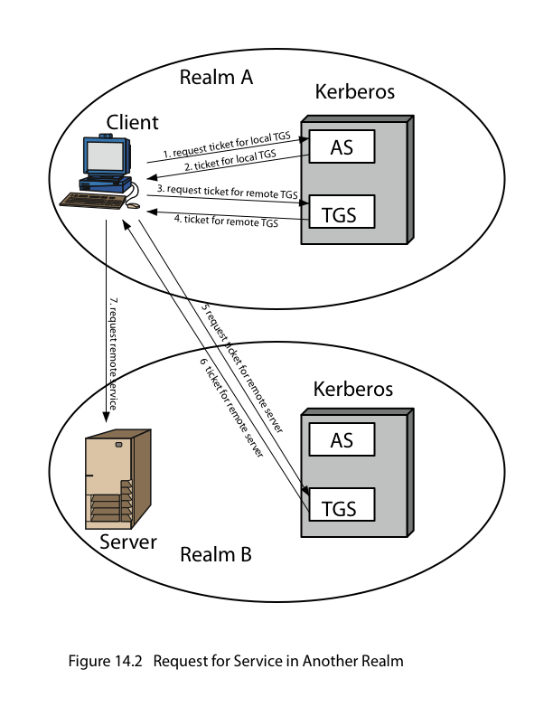

Slide 62


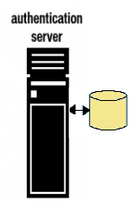
Kerberos Version 4
Pc=password of client
1- IDc + Pc+IDv
2- Ticket
3- IDc +Ticket
Ticket=Ekv[IDc,ADc,IDv]
kv=Secret Key between AS and V (Server)
IDc= User id of client

Slide 63
Kerberos Version 4
Weaknesses
Big load on AS (Provide secondary ticket-granting servers)
Repeated password entry (Password to AS seldom, tickets from TGS when needed, based on AS authentication)

Slide 64
Version 4 Authentication Dialogue
Problems:
Lifetime associated with the ticket-granting ticket
If to short  repeatedly asked for password
If to long  greater opportunity to replay
The threat is that an opponent will steal the ticket and use it before it expires

Slide 65
Strategies and Countermoves
What opponents of 4 can do
Wait for long-lived ticket-granting tickets and then reuse
Capture service-granting tickets and then use remaining time
Antitheft of ticket-granting tickets
AS provides both client with a secret, securely
Done by sending a session key
This procedure also makes service-granting tickets reusable

Slide 66
Kerberos Organization
Called a realm, it includes:
Kerberos server, which includes:
UID and hashed password for each user
Shared secret key with each user
Kerberos server includes both AS and TGS
Inter-realm issues
Kerberos servers in each realm are registered with each other (share a secret key)
TGS in server realm issues tickets to client on other realm (i.e RTGS)

Slide 67
Kerberos Version 5
Fixes version 4 environmental shortcomings
New elements for AS exchange:
Realm, Options, Times, Nonce
Client/server authentication exchange
Sub key, sequence number
Kerberos Ticket Flags

Slide 68
Difference Between Version 4 & 5
Point of Discussion | Version 4 | Version 5
Encryption Algorithm Used | DES only | DES & its variant, IDEA etc.
Identifiers | IP Address only | N/w Add, Type , length
Message byte ordering | Not Allowed | Allowed
Tickets Lifetime | Small | Renewable time span
Authentication forwarding | Same server only | Any server in realm
Inter-realm authentication Support (SCALING) | No Single Peer-to-peer | Yes Multiple Transitive (Cross-realm)
Replay Caches Support | No | Yes
Postdatabale Ticket | Not Available | Available
Forwardable (New Ticket) | Single ticket, same M/C, Same IP | Current credentials to get valid on another M/C

Slide 69
Attacks on Kerberos
Threats exist:
Modification Attack:- Network address of a workstation.
Replay Attack:-Eavesdrop while communication.
PW Guessing Attack:- User pretend to be another user.
Inter-session chosen Plaintext Attack:- As per V.5 Draft

Slide 70
Kerberos Mechanism Used By
Microsoft Passport Technology
Windows NT

Slide 71
Version 5 – Continued
Avoids double encryptions
Avoids PCBC (vulnerable to a cipher block exchange attack)
Session and sub-session keys
Pre-authentication – makes password attacks more difficult (but not impossible)

Slide 72
how much time is required for a brute-force attack for various key sizes. As can be seen, a single PC can break DES in about a year;
If multiple PCs work in parallel, the time is drastically shortened. And today’s supercomputers should be able to find a key in about an hour.
Key sizes of 128 bits or greater are effectively unbreakable using simply a brute-force approach. Even if we managed to speed up the attacking system by a factor of 1 trillion (1012 ), it would still take over 100,000 years to break a code using a 128-bit key

Slide 73
Multiple Encryption & DES
clear a replacement for DES was needed
theoretical attacks that can break it
demonstrated exhaustive key search attacks
AES is a new cipher alternative
prior to this alternative was to use multiple encryption with DES implementations
Triple-DES is the chosen form

Slide 74
Why not Double-DES?
could use 2 DES encrypts on each block
C = E_{K2}(E_{K1}(P))
concern at time of reduction to single stage
“meet-in-the-middle” attack
works whenever use a cipher twice
since X = E_{K1}(P) = D_{K2}(C)
attack by encrypting P with all keys and store
then decrypt C with keys and match X value
can show takes O(2⁵⁶) steps
Requires…Known Plain text

Slide 75
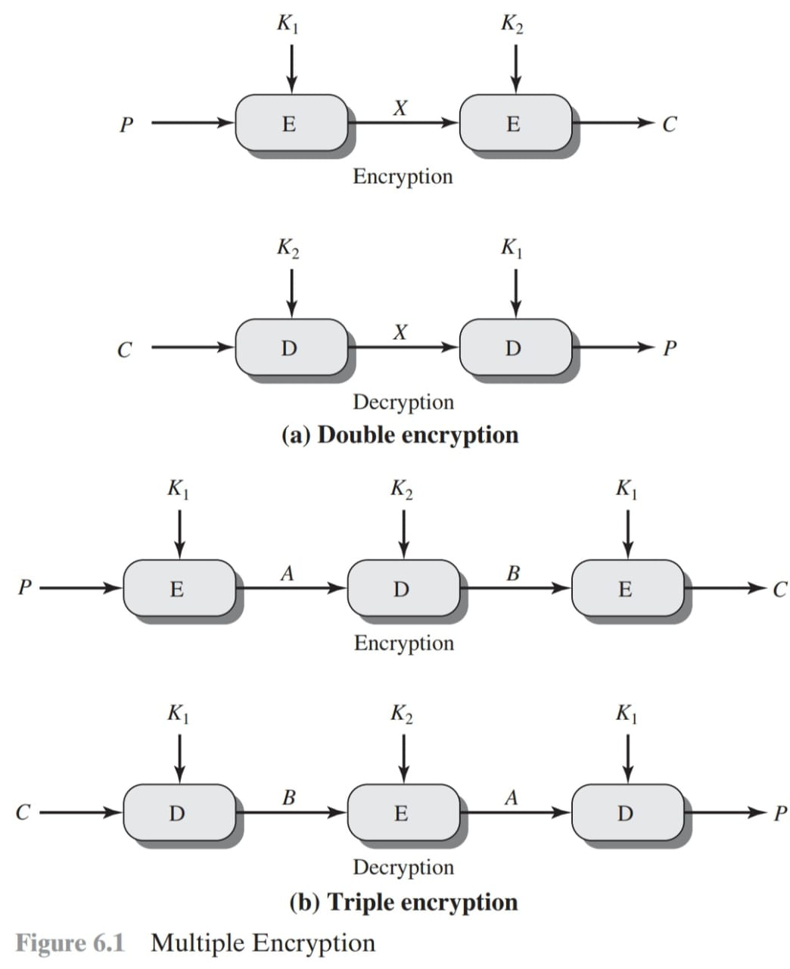

Slide 76
Triple-DES with Two-Keys
hence must use 3 encryptions
would seem to need 3 distinct keys
but can use 2 keys with E-D-E sequence
C = E_{K1}(D_{K2}(E_{K1}(P)))
n.b. encrypt & decrypt equivalent in security
if K1=K2 then can work with single DES
standardized in ANSI X9.17 & ISO8732
no current known practical attacks
several proposed impractical attacks might become basis of future attacks

Slide 77
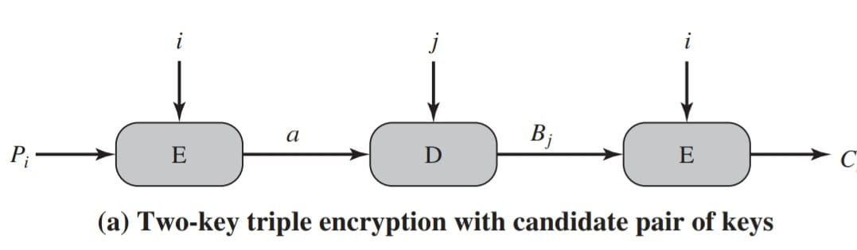

Slide 78
Triple-DES with Three-Keys
although are no practical attacks on two-key Triple-DES have some indications
can use Triple-DES with Three-Keys to avoid even these
C = E_{K3}(D_{K2}(E_{K1}(P)))
has been adopted by some Internet applications, e.g., PGP, S/MIME

Slide 79
Advanced encryption standard(AES):
The cipher takes a plaintext block size of 128 bits, or 16 bytes.
The key length can be 16, 24, or 32 bytes (128, 192, or 256 bits).
The algorithm is referred to as AES-128, AES-192, or AES-256, depending on the key length.
The input to the encryption and decryption algorithms is a single 128-bit block.
This block is depicted as a 4 * 4 square matrix of bytes.
This block is copied into the State array, which is modified at each stage of encryption or decryption. After the final stage, State is copied to an output matrix.
The key is depicted as a square matrix of bytes. This key is then expanded into an array of key schedule words.

Slide 80
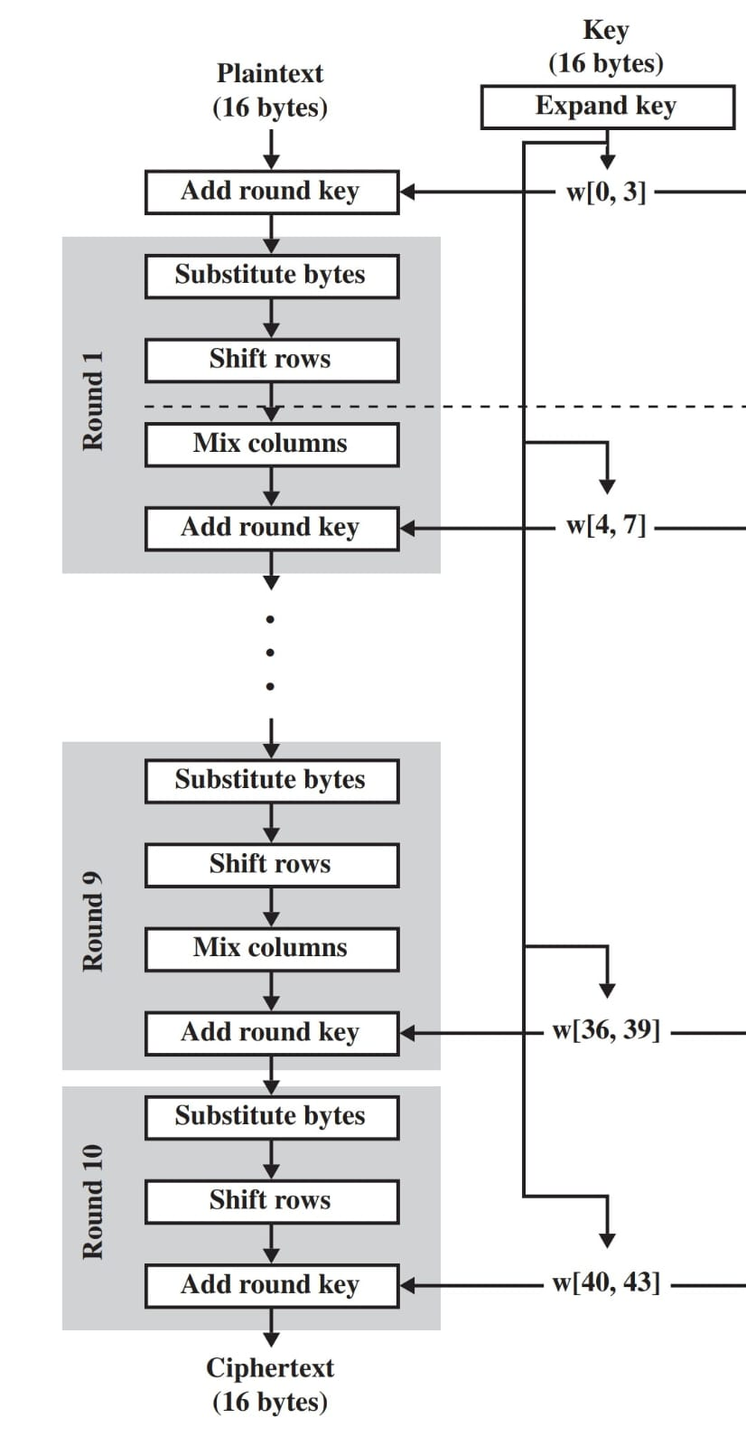
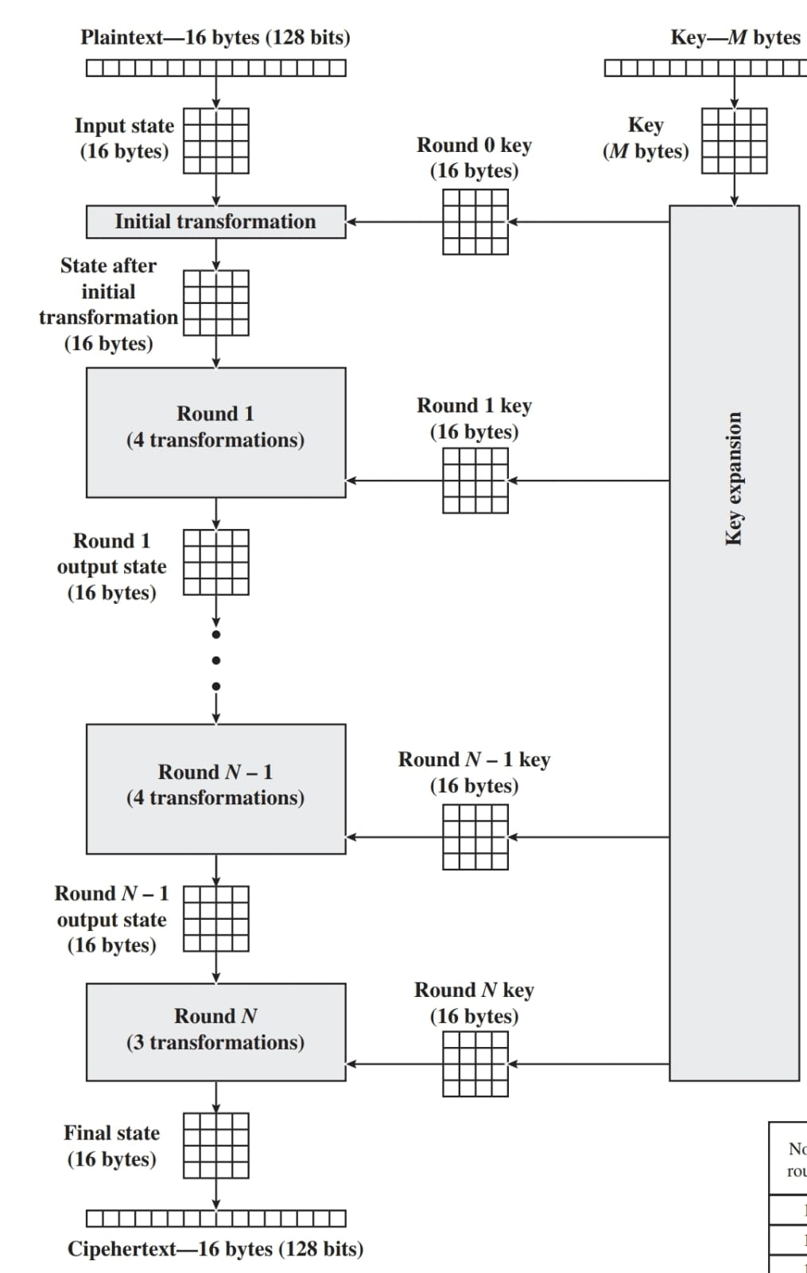

Slide 81
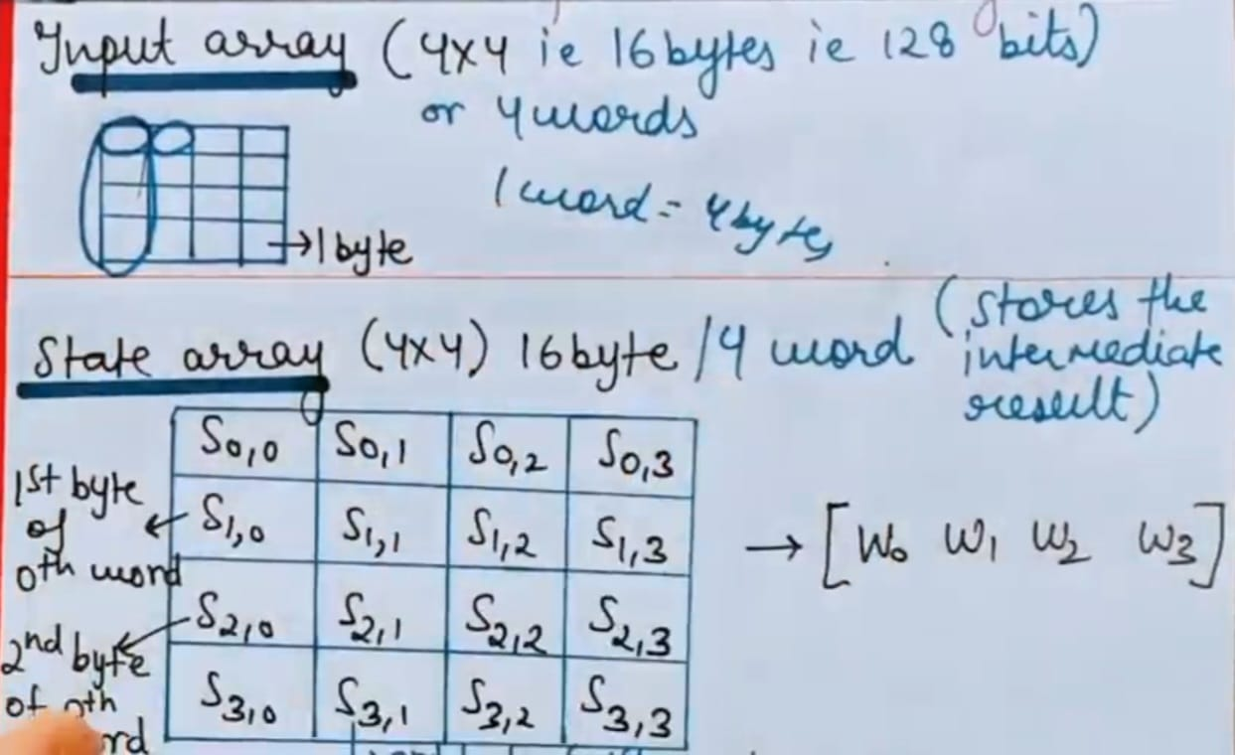

Slide 82
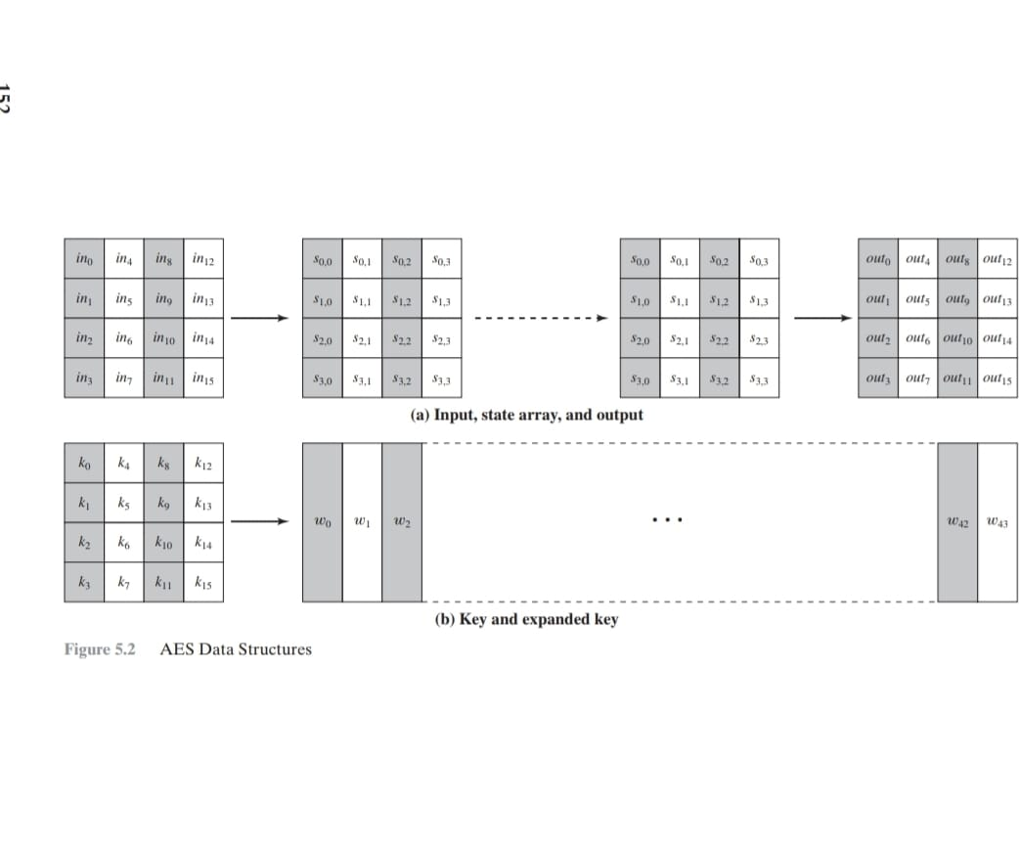

Slide 83
Substitute Bytes Transformation:The forward substitute byte transformation, called SubBytes, is a simple table lookup.
AES defines a 16 * 16 matrix of byte values, called an S-box that contains a permutation of all possible 256 8-bit values. Each individual byte of State is mapped into a new byte in the following way:
The leftmost 4 bits of the byte are used as a row value and the rightmost 4 bits are used as a column value. These row and column values serve as indexes into the S-box to select a unique 8-bit output value.

Slide 84
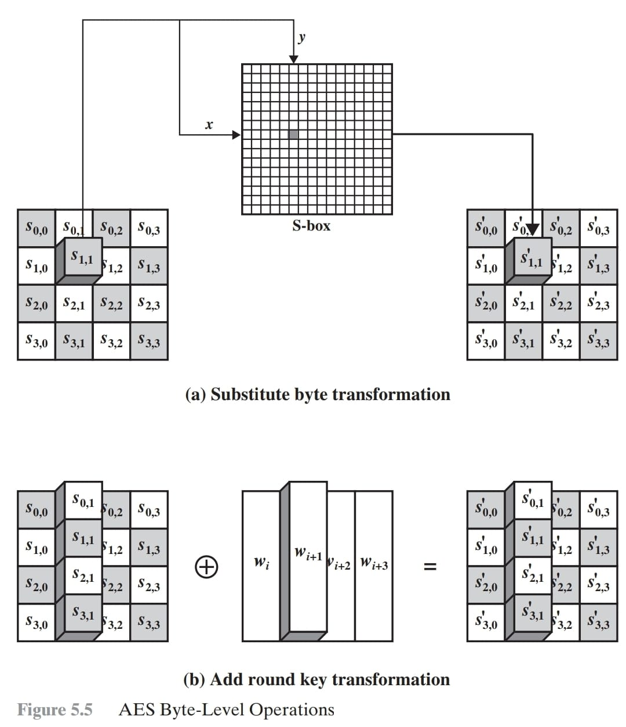

Slide 85
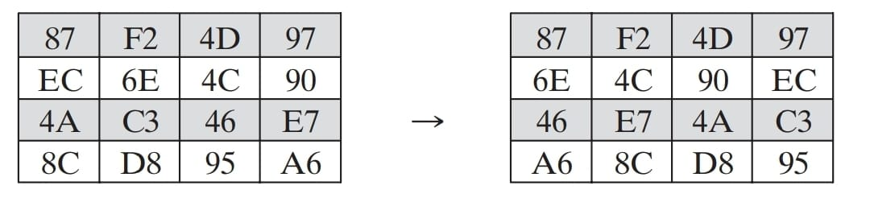
Shift Rows Transformation:
. The first row of State is not altered
For the second row, a 1-byte circular left shift is performed. For the third row, a 2-byte circular left shift is performed. For the fourth row, a 3-byte circular left shift is performed. The following is an example of ShiftRows.

Slide 86
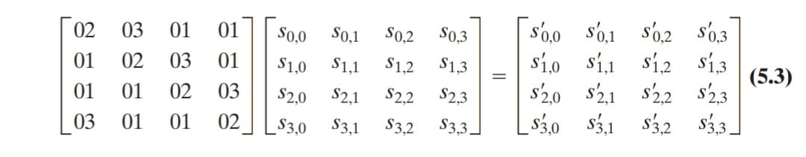
MixColumns Transformation:The forward mix column transformation, called MixColumns, operates on each column individually. Each byte of a column is mapped into a new value that is a function of all four bytes in that column. The transformation can be defined by the following matrix multiplication on State

Slide 87
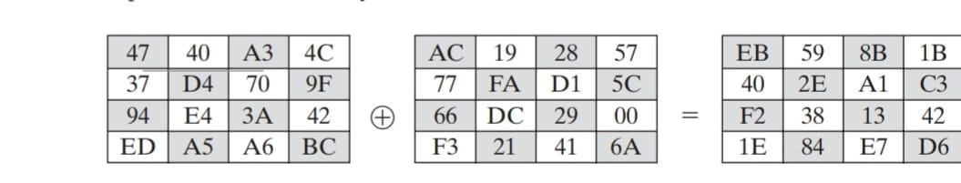
AddRoundKey Transformation:
Forward and Inverse Transformations In the forward add round key transformation, called AddRoundKey, the 128 bits of State are bitwise XORed with the 128 bits of the round key.
the operation is viewed as a columnwise operation between the 4 bytes of a State column and one word of the round key; it can also be viewed as a byte-level operation. The following is an example of AddRoundKey:

Slide 88
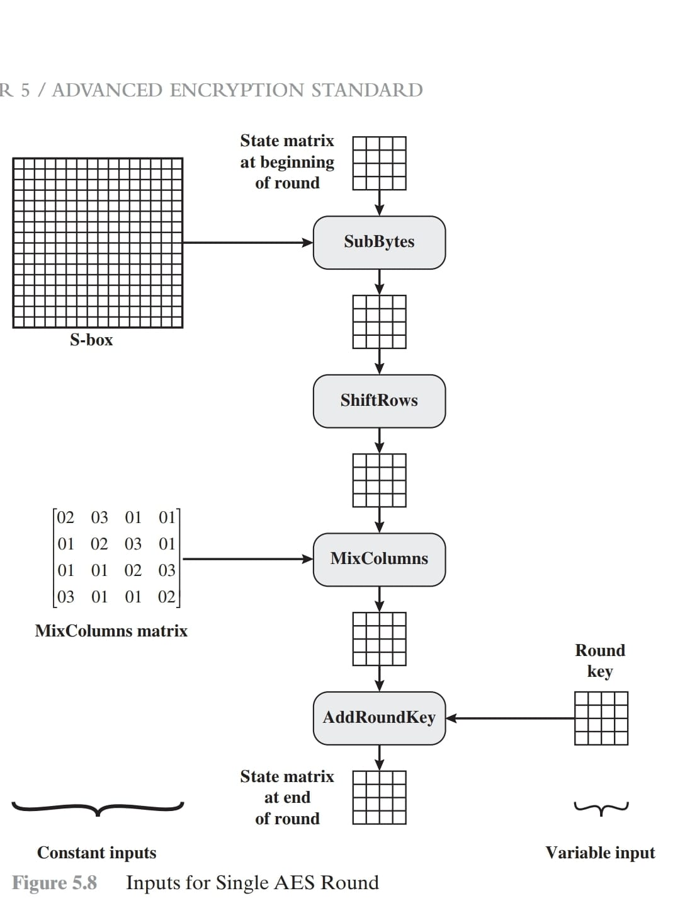

Slide 89
AES KEY EXPANSION:
Key Expansion Algorithm The AES key expansion algorithm takes as input a four-word (16-byte) key and produces a linear array of 44 words (176 bytes).
This is sufficient to provide a fourword round key for the initial AddRoundKey stage and each of the 10 rounds of the cipher

Slide 90
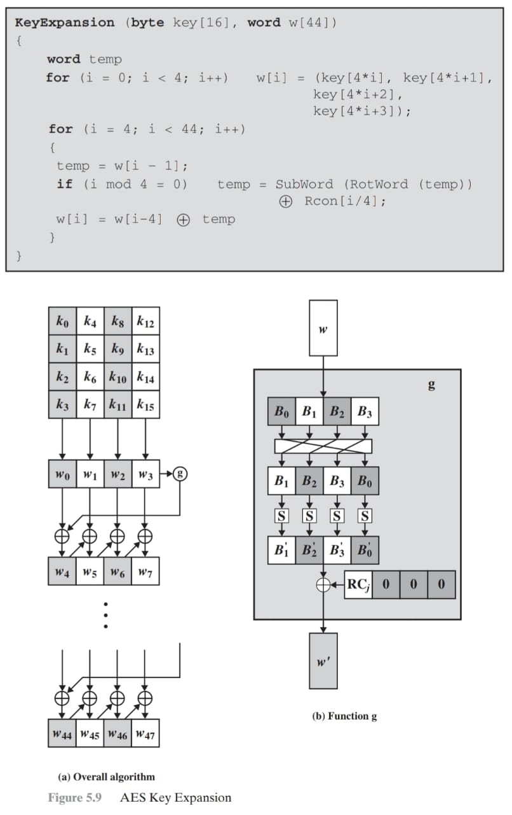

Slide 91
Unit 2 Algorithm Modes
ECB(electronic code book),
CBC(cipher block chaining),
CFB(cipher feedback mode),
OFB(output feedback mode)
CT(Counter mode)

Slide 92
Two Key Aspects of Algorithm
Algorithm type :- It defines what should be the size of PT.
Stream
Block
Algorithm Modes:- It defines the details of the cryptographic Algorithm.
It is a combination of the basic steps on block cipher & some kind of feedback from previous step

Slide 93
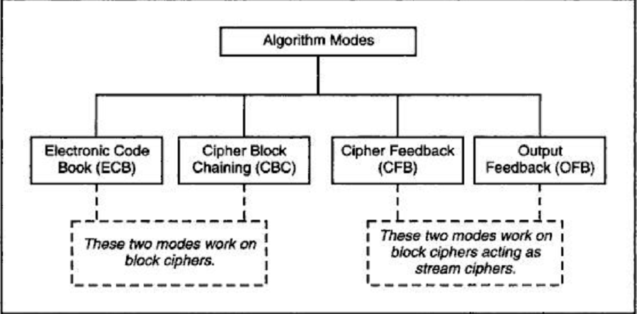
Algorithm Modes(print)

Slide 94
1.ECB(electronic code book)print
Encryption Process:-
PT divided 64 bits each.
Encrypted Independently
Same key
Decryption Process:-
Divide
Same Key
PT
Limitation:-
If Repeated PT Then Repeated CT
Small Messages where the scope of repeating quite less.

Slide 95
Electronic Codebook mode (ECB) print
Message is broken into independent blocks which are encrypted
Each block is a value which is substituted, like a codebook, hence name
Each block is encoded independently of the other blocks
C_{i} = _{K1}(P_{i})
Uses: transmission of single values.(i.e;-PW or key for E/D) in secure fashion.
E=Encryption , D= Decryption
Notes:
ECB is the simplest of the modes, where each block is en/decrypted independently of all the other blocks, and is used when only a single block of info needs to be sent (eg. a session key encrypted using a master key).

Slide 96
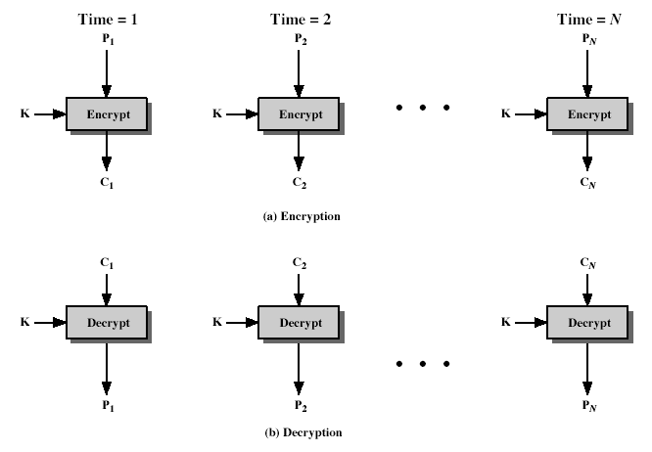
Electronic Codebook Book (ECB) print
Notes:
Stallings Fig 3-11.

Slide 97
Electronic Code Book (ECB) Mode(print)
Plaintext
Block 1 Block 2 Block 3 Block 4 Block 5 …
Block Encryption
E(block)
E(block)
E(block)
E(block)
E(block)
E(block)
Ciphertext
Block 1 Block 2 Block 3 Block 4 Block 5 …
Pad last block, if necessary

Slide 98
2.CBC(cipher block chaining)(print**)
Different CT for every PT including identical/repeat PT.
Feed back Mechanism used(i.e: Chaining).
Initialization Vector(IV) for creating unique message.
Random Block called IV can be XOR with plain text in First step.
Not a secret – just prevents a codebook. Often times a timestamp.
I/O-> IV XOR PT Block 1 = CT Block 1<- we can call it as New IV for next step.
Same key
Dependent on previous one.

Slide 99
Message is broken into blocks
But these are linked together in the encryption operation
Each previous cipher blocks is chained with current plaintext block, hence name
Use Initial Vector (IV) to start process (Block 1)
C₋₁ = IV
C_{i} = _{K1}(P_{i} XOR IV )
From block 2
C_{i} = _{K1}(P_{i} XOR C_{i-1})
Uses: bulk data encryption, authentication
Notes:
To overcome the problems of repetitions and order independence in ECB, want some way of making the ciphertext dependent on all blocks before it. This is what CBC gives us, by combining the previous ciphertext block with the current message block before encrypting. To start the process, use an Initial Value (IV), which is usually well known (often all 0's), or otherwise is sent, ECB encrypted, just before starting CBC use. CBC mode is applicable whenever large amounts of data need to be sent securely, provided that its available in advance (eg email, FTP, web etc)

Slide 100
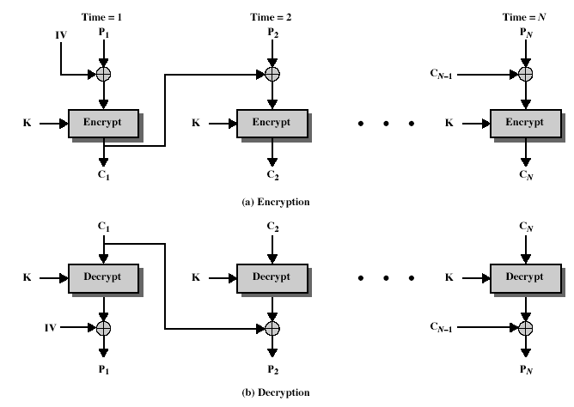
Notes:
Stallings Fig 3-12.

Slide 101
Limitations of CBC(print)
CBC mode has few security issues and error propagation :
1.Error propagation : A single error in a cipher text block can affect the decryption of all subsequent blocks
2.Sensitivity to bit errors : CBC is sensitive to bit error
3.Necessity for unique and unpredictable IV
4.Vulnerability to attack: To use padded CBC block cipher safely, you must combine them with data integrity check, such as keyed hash message authentication code
Notes:
CBC is the generally used block mode. The chaining provides an avalanche effect, which means the encrypted message
cannot be changed or rearranged without totally destroying the subsequent data.
One issue is how to handle the last block, which may well not be complete. In general have to pad this block (typically with 0's), and then must recognise padding at other end - may be obvious (eg in text the 0 value should usually not occur), or otherwise must explicitly have the last byte as a count of how much padding was used (including the count). Note that if this is done, if the last block IS an even multiple of 8 bytes, will have to add an extra block, all padding so as to have a count in the last byte.

Slide 102
3.Cipher Feed Back (CFB)
Message is treated as a stream of bits
Added to the output of the block cipher
Result is feed back for next stage (hence name)
Standard allows any number of bit (1,8 or 64 or whatever) to be feed back
denoted CFB-1, CFB-8, CFB-64 etc
Is most efficient to use all 64 bits (CFB-64)
C_{i} = P_{i} XOR _{K1}(C_{i-1})
C₋₁ = IV
Uses: stream data encryption, authentication
Notes:
If the data is only available a bit/byte at a time (eg. terminal session, sensor value etc), then must use some other approach to encrypting it, so as not to delay the info. Idea here is to use the block cipher essentially as a pseudo-random number generator (see stream cipher lecture later) and to combine these "random" bits with the message. Note as mentioned before, XOR is an easily inverted operator (just XOR with same thing again to undo). Again start with an IV to get things going, then use the ciphertext as the next input. As originally defined, idea was to "consume" as much of the "random" output as needed for each message unit (bit/byte) before "bumping" bits out of the buffer and re-encrypting. This is wasteful though, and slows the encryption down as more encryptions are needed. An alternate way to think of it is to generate a block of "random" bits, consume them as message bits/bytes arrive, and when they're used up, only then feed a full block of ciphertext back. This is CFB-64 mode, the most efficient. This is the usual choice for quantities of stream oriented data, and for authentication use.

Slide 103
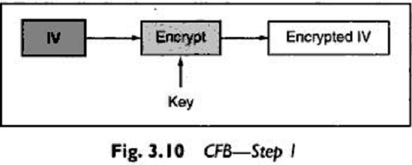
Step 1
64 bit IV PT
Kept in Shift Register
Encrypted
64 bit IV CT

Slide 104
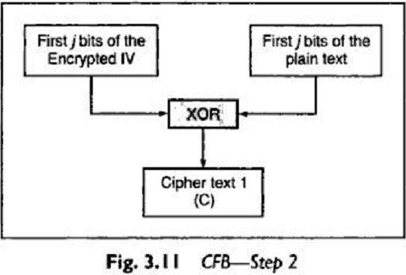
Step 2
Leftmost bit (i.e MSB)

Slide 105
Step 3
Left Shift IV by j positions.
Move j bits of C into the rightmost side of blank IV .
Step 1 through 3 continue until all the PT units are encrypted.
*C=Cipher Text from step 2.
Left shift IV by j position
IV
Move j bit of C into the rightmost side of IV
IV
C

Slide 106
Cipher Feedback Mode (CFB)
1 unit is 1/N block
Shift Register (1 Block wide)
C _{I-6} C _{I-5} C _{I-4} C _{I-3} C _{I-2} C _{I-1}
Block Encryption
E(register)
Encrypted Register
Leftmost
After each unit, shift input register and insert the most recently generated unit of cipher text
Shown by <……………….
First j bit of the Plain text
Cipher text
(C)
XOR
output

Slide 107
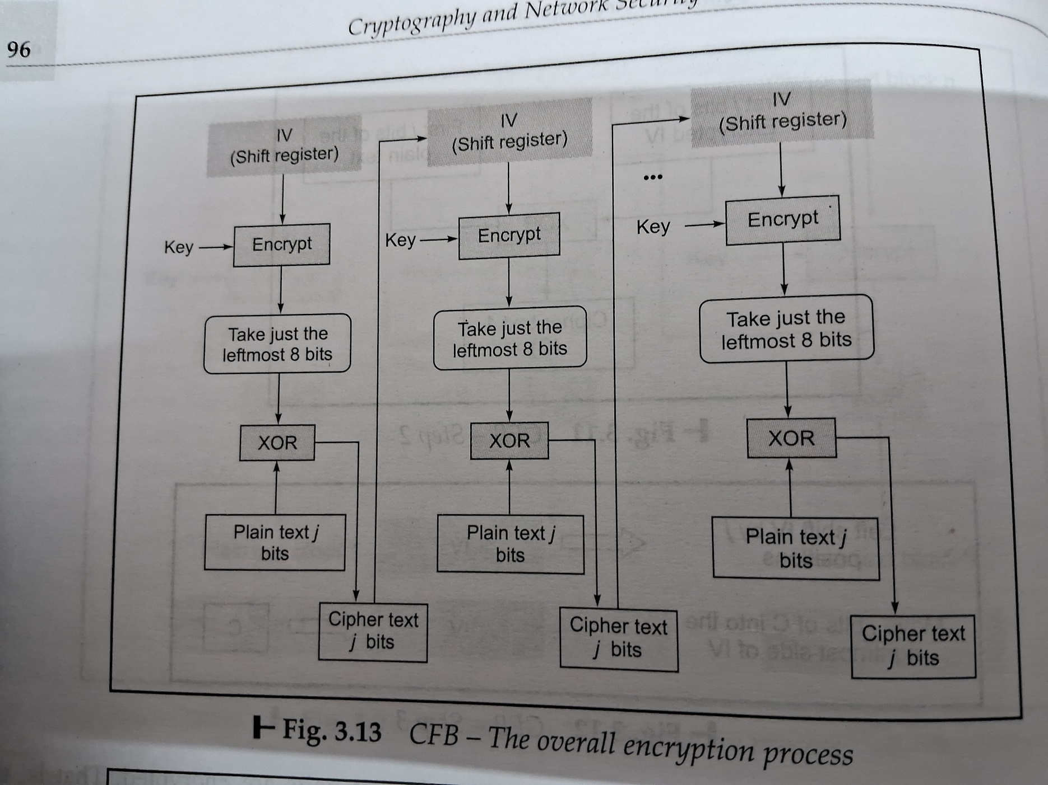
Cipher FeedBack (CFB)
Notes:
Stallings Fig 3-13.

Slide 108
Limitations of CFB
Errors propagation if Ci bit contain error.
Ci is feed back as input to the shift register & would corrupt the other bits in the message.
Notes:
CFB is the usual stream mode. As long as can keep up with the input, doing encryptions every 8 bytes. A possible problem is that if its used over a "noisy" link, then any corrupted bit will destroy values in the current and next blocks (since the current block feeds as input to create the random bits for the next). So either must use over a reliable network transport layer (pretty usual) or use OFB.

Slide 109
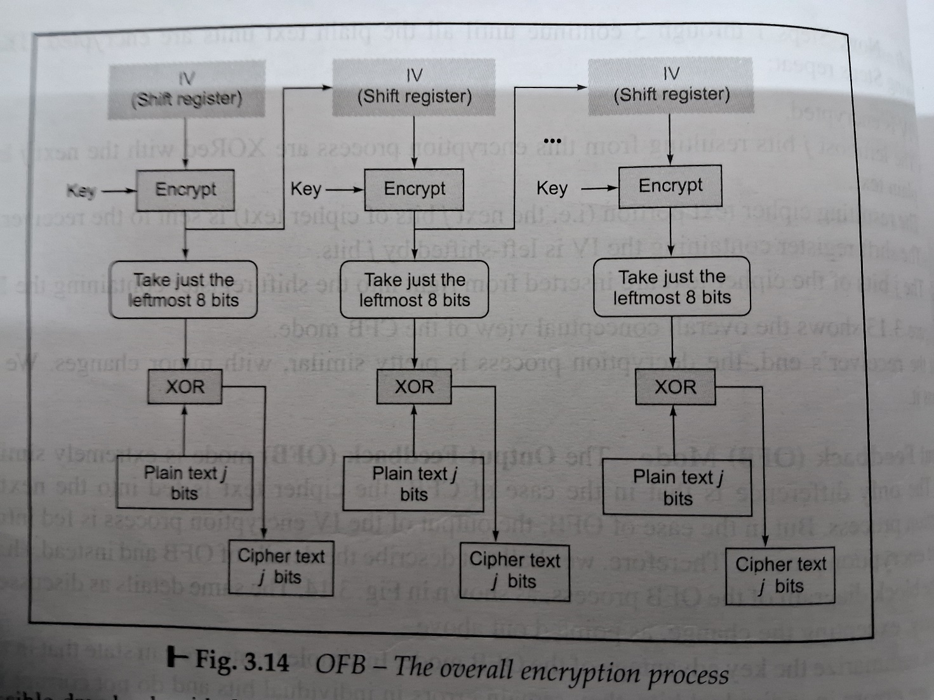
4.OFB(Output feedback mode)
The output of the IV encryption process is feed into the next of the encryption process.

Slide 110
Output Feedback Mode (OFB)
1 unit is 1/N block
Shift Register (1 Block wide)
C _{I-6} C _{I-5} C _{I-4} C _{I-3} C _{I-2} C _{I-1}
Block Encryption
E(register)
Encrypted Register
Leftmost
After each unit, shift input register and insert the leftmost unit of the encrypted register.
First j bit of the Plain text
Cipher text
(C)
XOR
output

Slide 111
Advantage Of This Scheme:-
Bit error do not get propagated(i.e;-Other bits are not affected)
If there are error in individual bits will not corrupt the whole message.
disadvantage Of This Scheme:-
Attacker changes both the cipher text and the checksum at the same time hence there is no way to detect this change.

Slide 112
5.CTR(Counter)
It uses sequence numbers called as counters as the inputs to the algorithm.
After each block is encrypted, the next counter value is used to fill the register.
Usually, a constant is used as a initial counter value and is incremented by 1 for every iteration , hence name
The size of counter block is same as PT.
Encryption:- Decryption:-
Counter is encrypted ->Same Sequence is used
XOR’ed with PT -> XOR’ed with CT
CT ->PT

Slide 113
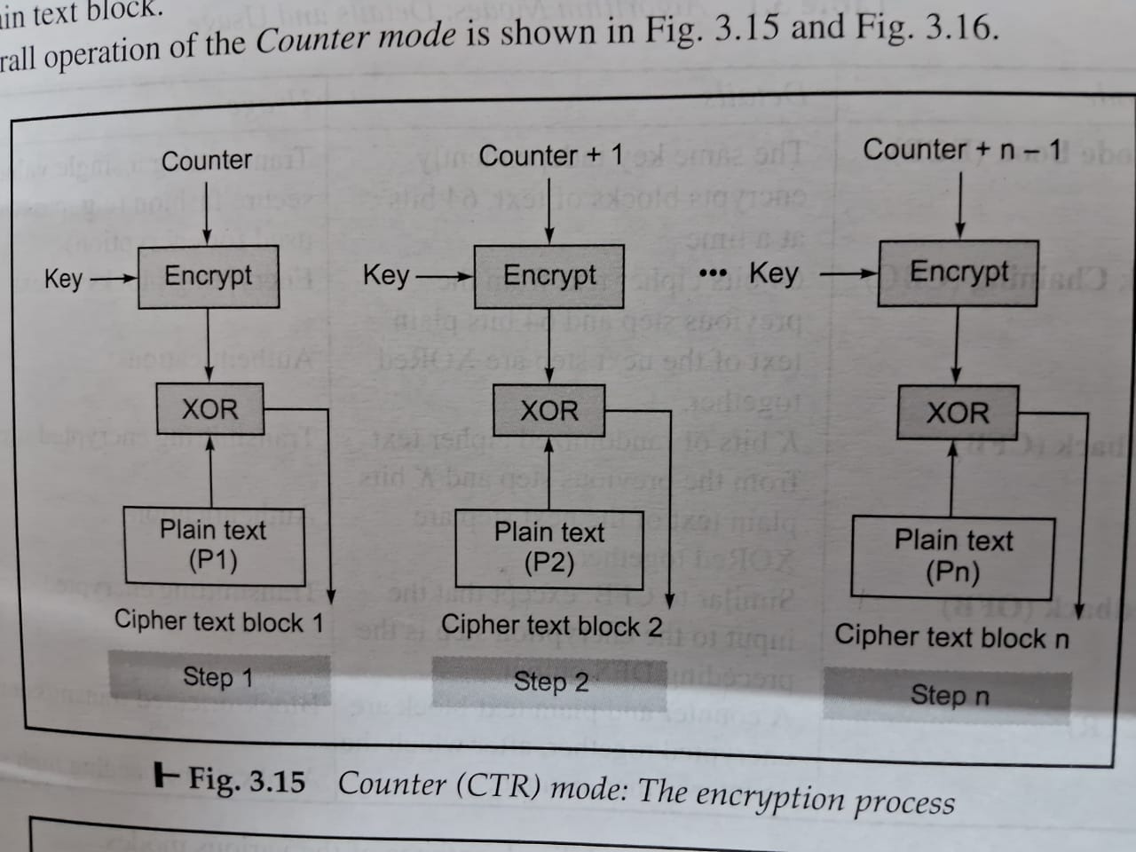

Slide 114
Advantages & Limitations Of CRT
Encryption & Decryption process can be done in parallel on multiple text blocks.
No chaining process is involved.
Faster execution Speed.
Used in Multiprocessing to reduce overall processing time.
Pre processing can be achieved to prepare the O/P of the encryption boxes that I/P to the XOR operation.
Encrypt
Counter
O/P
Key

Slide 115

Unit 1
Security Basics

Slide 116
CONTENT
INTRODUCTION
1.1 SECURITY
1.2 WHY STUDY INFORMATION SECURITY
1.3 NEED OF SECURITY
1.4 SOME REAL TIME ATTACK
1.5 MODERN NATURE OF ATTACK
1.6 PRINCIPLE/GOALS OF SECURITY(print)
1.7 CATEGORY OF COMPUTER SECURITY
1.8 SECURITY ATTACKS(print)

Slide 117
How safe is your information?
Recent events show that commercial, personal and sensitive information is very hard to keep secure, and some estimates point to 2007 as being the worst year on record for data loss.
As breaches in information security continue to make headline news, it is becoming increasingly clear that technological solutions are not the only answer.
Research conducted in 2007 suggests that at least 80% of data leakages are caused by staff rather than IT systems (source: Financial Times/Forrester Research, Nov-07).
It is clear therefore that Information Security should be viewed as a management function rather than one of IT alone.
Here, the syllabus outline the main management principles designed to help you secure your data, and raise awareness of the issues involved.

Slide 118
1.1 SECURITY
Challenges in Security?
1.Use of computer with internet
2. Software tools are available freely
3. Importance of information
4.Lack of awareness/ignorance/hesitation

Slide 119
To protect the operation of any organization
1.Physical Security:- Access control to physical device
E.g:- Pen drive, Hard drive, CD/DVD, Computer,
2. Private Security :- Individual or group
3. Project Security :- Design , Code operation security

Slide 120
1.2 Why Study Information Security
Businesses collect mass amounts of data about their customers, employees, and competitors.
Most of this data is stored on computers and transmitted across networks.
If this information should fall into the hands of a competitor, the result could be loss of business, lawsuits and bankruptcy.
Protecting corporate data is no longer an option, it is a requirement.

Slide 121
Protecting information and information systems from unauthorized access, use, disclosure, disruption, modification, or destruction.

Slide 122
1.3 The Need for Security(Current Scenario)
Now a days Importance of data was truly realized.
Financial & Personal data
Therefore various areas in security began to gain prominence.
Typical Examples of Basic Security Mechanism:
Authenticate a User->id, pw
Encode->DB->Not Visible to user who do not have the right permission.
Organization employed their own mechanism.

Slide 123
The Need for Security In Modern Life
Internet took the world by storm.
Technology Improved
Communication Infrastructure became extremely mature.
Newer & newer applications begins to developed for various user demands & need.
Soon peoples realized that basic security measures were not quite enough.

Slide 124
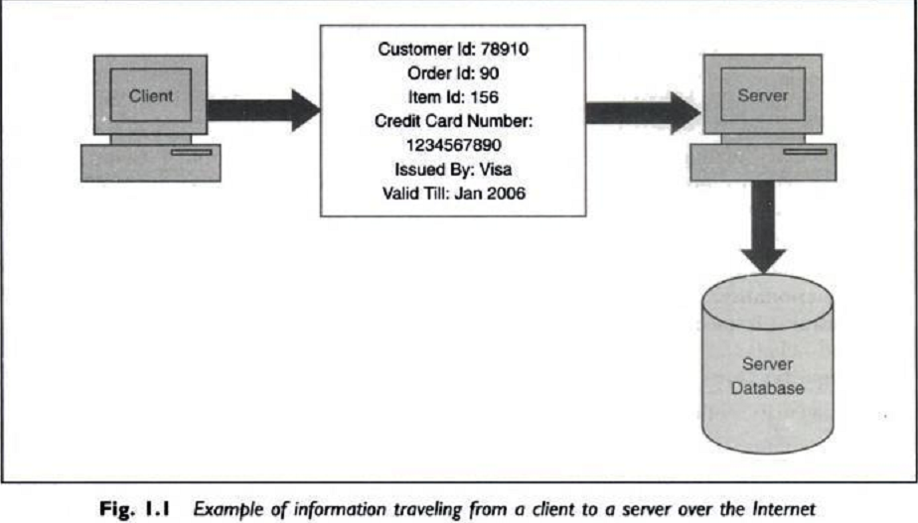
Information traveling from a client to a server over the internet.

Slide 125
1.4 Some real time attacks
Russian Attacker Maxim actually manage to intruder into a merchant Internet site & obtained 300,000 credit card numbers from its DB.
He then attempted extortion by demanding protection money($100,000) from the merchant.
The merchant refused to oblige.
Following this, the attacker published about 25,000 of the credit card numbers on the internet!
Some banks reissued all the credit cards at a cost of $20 per card & others forewarned their customers about unusual entries in their statements.

Slide 126
Consequences of Attack
Great Losses-both in terms of finance & goodwill.
Cost of attack $20*300000=$6M
Another Example:-
1999 Swedish hacker broke into Microsoft’s Hotmail Website & created a mirror site.
This allowed anyone to enter any Hotmail user’s email id & read their emails.
2005 survey about the losses that occur due to successful attacks on security. $455,848,000
Next year this figure reduced to $201,757340!

Slide 127
1.5 Modern Nature Of Attack
Automating Attacks:-
Traditional Attack: Produce Coins using machinery & Bring them into circulation.
Modern Attack: Steal half a dollar from million accounts in a few minutes time digitally.
2. Privacy Concern:-Every Company are collecting & processing lots of information about us. Without we
realizing when & how it is going to be used.
3. Distance does not matter:- Attack Can be launched from the distance.
E.g:- In 1995, a Russian hacker broke into Citibank’s computer remotely, stealing $12M.
Although the attacker was traced, it was very difficult to get extradited him for the court case.

Slide 128
1.6 Principle/Goals Of Security
These r the 4 chief principles of security.
Confidentiality:- Is msg seen by someone else?
Authentication:- Do u trust the sender of msg?
Integrity:- Is the message changed during transmit?
Non-repudiation:- Can sender refute the msg?
Above principles r related to a particular message.
There r 2 more linked to overall system as a whole.
Access Control:- Who can Access what? [ACL]
Availability:- Information should be available timely.
Notes:
smit

Slide 129
Confidentiality
Confidentiality is the process of preventing disclosure of information to unauthorized individuals or systems.
Examples: Credit card
Confidentiality is necessary, but not sufficient to maintain privacy

Slide 130
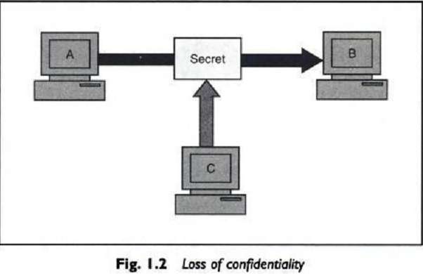
Interception Causes Loss of Message Confidentiality

Slide 131
Authenticity
In computing, e-Business and information security it is necessary to ensure that the data , transactions, communications or documents (electronic or physical)
are genuine (i.e. they have not been forged or fabricated.)
Examples: Passport, Credit card Accounts, academic transcripts

Slide 132
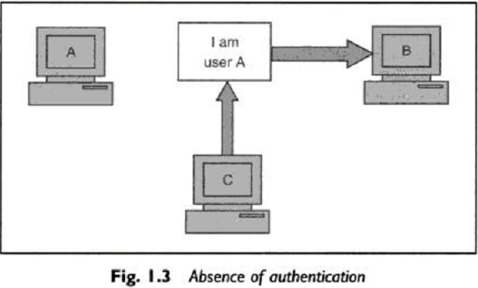
Fabrication is possible in absence of proper authentication

Slide 133
Integrity
Integrity means that data cannot be modified/change without Authorization
Examples: Manual deletion or alteration or creation of important data files, Virus infection, Employee altering their own salary , website vandalism, polling fraud.

Slide 134
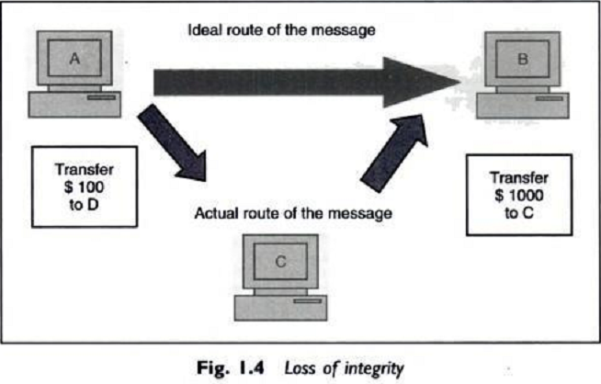
Modification Causes Loss of Message integrity

Slide 135
Non-Repudiation
It is a complex term used to describe the lack of deniability of ownership of a message, piece of data, or Transaction.
Examples: Proof of an ATM transaction, a stock trade, or an
email

Slide 136
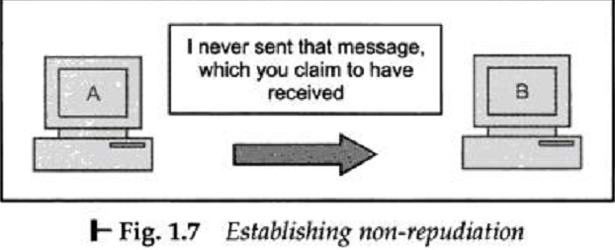
It does not allow the sender of a message to refute the claim of not sending that message

Slide 137
Access Control
Role Management->User Side->Which user can do what.
Rule Management->Resource Side->Which resources r accessible and under what circumstances.
Access Control List is subset of Access Control Matrix.

Slide 138
Availability
For any information/system to serve its purpose,
The information must be accessible & usable when it is needed.
Computing systems used to store and process the information, the security controls used to protect it, and the communication channels used to access it must be functioning correctly.
Examples: Power outages, Hardware failures,
System upgrades and Preventing denial-of-service
attacks

Slide 139
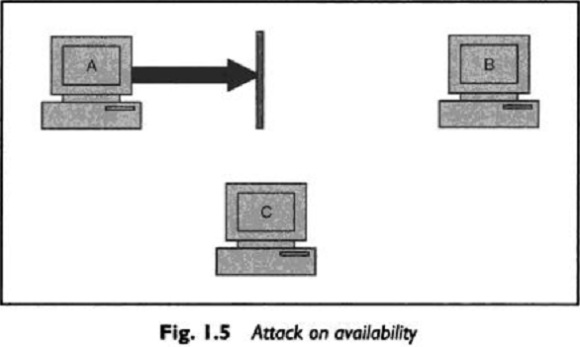
Interruption puts the availability of resources in danger.

Slide 140
1.7 CATEGORY OF COMPUTER SECURITY
Cryptography:- Mathematical “scrambling’’ of data.
Data Security:- Protective measures, keep safe from un- authorized access, privacy, prevent breaches , etc.
Computer Security Model:-
It Depends on computer architecture, specification, security issues, protection mechanism.
Act as a framework for information system security policy.

Slide 141
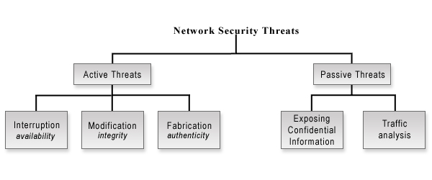
1.8 Security Attack

Slide 142
Types of Attack
Attacks: A Technical View
Theoretical Concepts behind this attack.
Inception:- Copying of data & program & listening to N/W Traffic.
Fabrication:-Attacker may add fake records to a database. Creation of illegal objects on the computer system.
Modification:-Attacker modifies Value of DB
Interruption:- Resources became unavailable, lost or unusable. Causing problems to a H/W device, erasing program, Data or OS components.

Slide 143
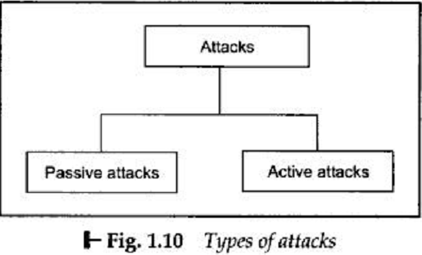
Further Grouped in two types:

Slide 144
1.Passive Attack
Attacker eavesdropping or monitoring of data transmission.
Aims to obtain information that is in transmit.
No Modification
1. Release of message contents
2.Traffic analysis:attempt of analyzing (encoded)messages to come up with likely patterns are the work of the traffic analysis attack.

Slide 145
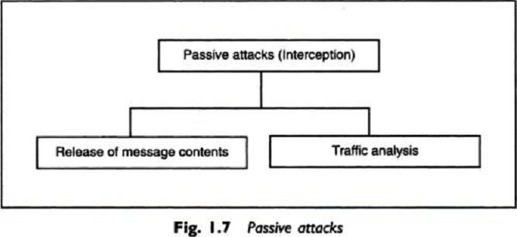
Classification of Passive Attack

Slide 146
2.Active Attack
1.Masquerade:Trying to pose as another entity
2.Replay attack:A user captures a sequence of events or some data units and resends them
3.Alteration of messages:Involves some changes to the original message
4.Denial Of Services:Attacks make an attempt to prevent legitimate users from accessing some services,which they are eligible for.

Slide 147
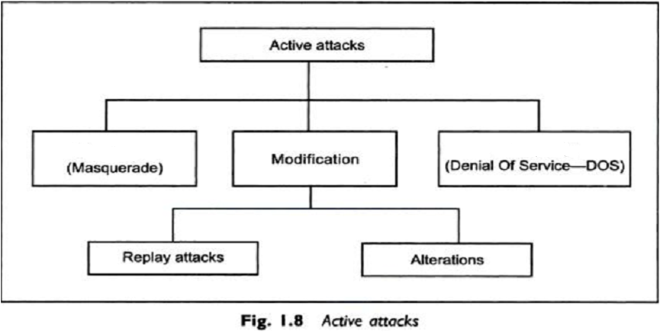
Classification of Active Attack
Masquerade :- Trying to pose as another entity

Slide 148
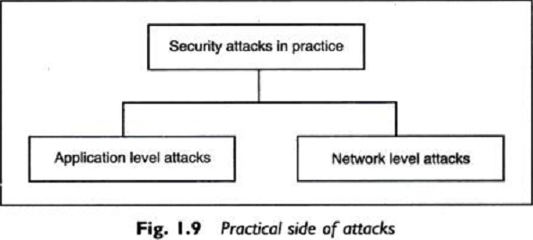
Practical Side Of Attack

Slide 149
Assignment:1(Read and Write)
Virus
Worms
Trojan Horse
Phishing
Sniffing and Spoofing
Applets & ActiveX Controls
Cookies
Java Script,VB Script, Jscript

